Slide 1
Introduction to quantum mechanics

Slide 2
Quantum mechanics: specific properties used for quantum computing
Superposition of a states in a Quantum System
Entanglement
Connection between Reversibility Computation and Physical Systems
Quantum Error Correction

Slide 3
What is quantum mechanics?
Quantum mechanics (QM) is a theory that describes properties of nature on a very small scale.
QM is only applicable on an atomic scale similar to Einstein’s theory of relativity which is mostly applicable on a very large scale;
when objects travel at a speed close to speed of light or large gravitational fields.
QM is used to calculate effects on a molecular, atomic and subatomic scale

Slide 4
What is superposition?
Classical physics defines the concept of superposition as when two physical quantities are added together and make a third physical quantity that is entirely different from the original two physical quantities

Slide 5
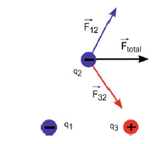
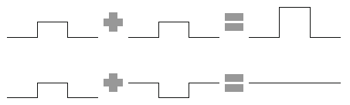
Classical superposition - examples
Constructive and Destructive Interference
due to classical Superposition
Superposition Application to compute the flow of current
due to multiple voltage sources in an Electric circuit
Total Electric Force on a charge
due to two other charges

Slide 6
Quantum superposition
Quantum Superposition is a phenomenon associated with Quantum Systems
Quantum systems includes small objects such as nuclei, electrons, elementary particles, and protons.
The small objects of Quantum system are observed to have the wave-particle duality and other non-classical effects.

Slide 7


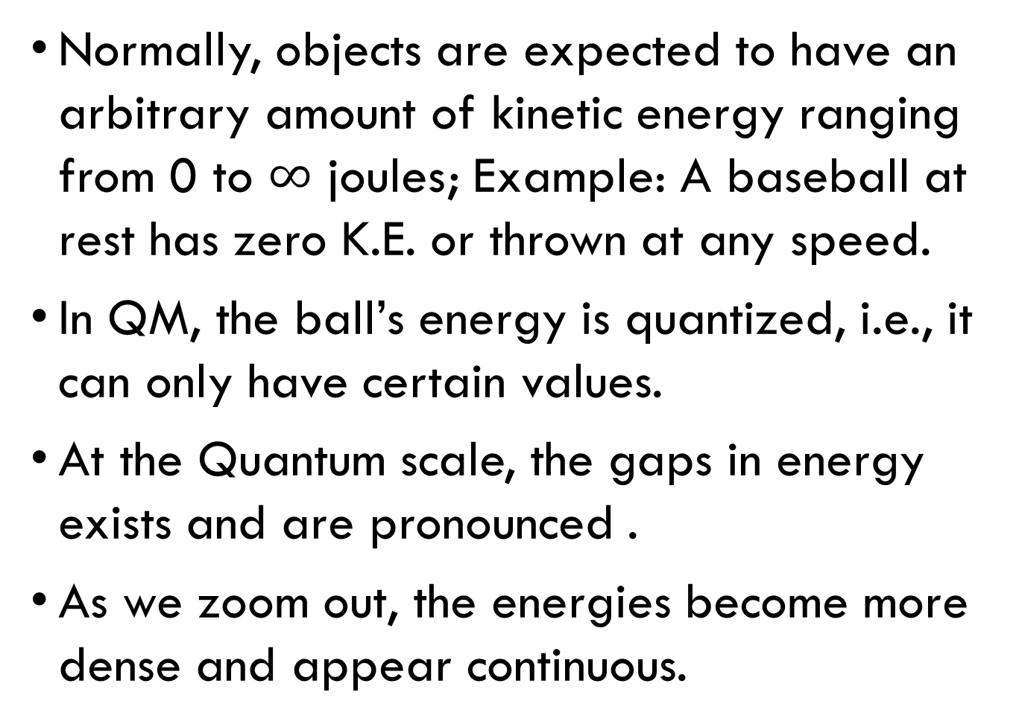
Quantum superposition – cont.
Normally, objects are expected to have an arbitrary amount of kinetic energy ranging from 0 to $∞$ joules; Example: A baseball at rest has zero K.E. or thrown at any speed.
In QM, the ball’s energy is quantized, i.e., it can only have certain values.
At the Quantum scale, the gaps in energy exists and are pronounced .
As we zoom out, the energies become more dense and appear continuous.
Quantum System
Zoom Out using
A Classical Lens
Classical System

Slide 8
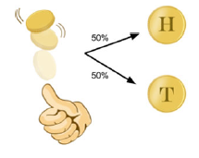
Quantum superposition – coin toss analogy.
A coin has a 50/50 probability of landing either heads or tails
What state is the coin while it is in the air?
Is it heads or tails?
The coin is in a superposition of both heads and tails.
When the coin lands it has a definite state i.e., we observe the coin, we are making a measurement which destroys the superposition
The coin can be either heads or tails, or a combination of heads and tails while flipped in the air.
All of these cases are called states of the coin system

Slide 9
Quantum superposition
A System at any given time can be described as being in a particular or definite state
The definite state is related to its quantized values
Heads or tails of a tossed coin
Electron orbiting a hydrogen atom can be in the ground state or an excited state
A Quantum system is special because it can be in a superposition of the definite states i.e., both heads and tails simultaneously, ground state and excited state simultaneously.
Quantum Systems can exist in a superposition state, and measuring the system will collapse the superposition state into one of the definite classical states

Slide 10
Quantum superposition - conclusion
A particle in a Quantum superposition exists as a combination of different definite states at the same time
Each definite state of Quantum System has a given probability of being observed
Measurement destroys the Superposition resulting in one definite state.

Slide 11
Quantized or continuous example 1
Is Electric Charge a quantized or continuous object?
Quantized: e = 1.6x10⁻¹⁹ C
Time?
Continuous
Length?
Space is Continuous
Cash?
Quantized to $0.01
Color of Paint?
Continuous because the frequency of lights which causes color is continuous.

Slide 12
Quantized or continuous example 2
A new paint color is created by mixing together 50% red paint and 50% yellow paint.
Assume the new paint behaves like a Quantum system in a half yellow and half red quantum Superposition
Let an artist paint a picture of sunset.
What is the color of the Sun?
It is either full red or full yellow
The artist painting the Sunset is measurement of the new Paint Quantum System
The measurement should collapse the Quantum system in the half yellow and half red quantum Superposition to one of the definite states “Red” or “Yellow” Color

Slide 13
Quantized or continuous example 3
A controversial picture of a dress is always seen as blue/black by student ‘A’ and always seen as white/gold by student ‘B’.
Is the dress in a Quantum Superposition?
No
If 100 copies of the dress pictures are shown to student ‘A’, the student ‘A’ will always see blue/black and similarly student ‘B’ will always see white/gold
In a 50/50 Quantum superposition each student would see around 50 pictures as blue/black and the rest as white/gold
The two states must be an intrinsic property of the dress rather than depending on the observer.

Slide 14
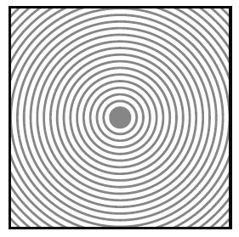
Wave-particle duality and probabilistic nature
Consider a square pool filled with water
Imagine dropping a marble in the center of the square pool
You will notice a circular patterns of wave moving to the outside of the pool
The wave will start at the center of the pool and travel to the edges
The further the wave travels, the lower its height gets
The height of the water impacting the edges will be lower in the corners than elsewhere

Slide 15

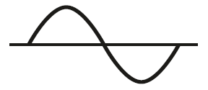
Wave-particle duality and probabilistic nature
If the water hits one side of the square pool with equal force spread across the entire width, the wave will not be circular
Instead the wave will travel to the other side of the pool in a straight line
The wave traveling circular or in a straight line can be represented as sine wave

Slide 16
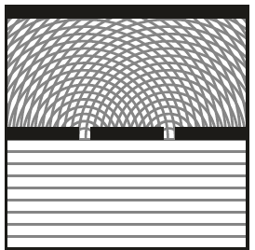

Wave-particle duality and probabilistic nature – double slit experiment
Imagine a divider halfway the square pool with two slits.
The traveling wave will hit the divider for most of it
Where there are slits, the wave will move forward
Since there are two slits, two separate circular waves will form, and eventually meet each other
Finally, when the waves reach the edge furthest from the initial pushed edge, a pattern is created due to constructive and destructive interference
It is same pattern that is observed
with light, proving light is a wave

Slide 17
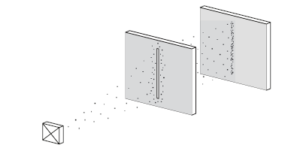
Wave-particle duality and probabilistic nature – double slit experiment
Instead of water or light, repeat the double slit experiment with electrons (particles)
Using a barrier with a single slit, we can observe some electrons hitting the surface behind the barrier indicating passing through the slit

Slide 18
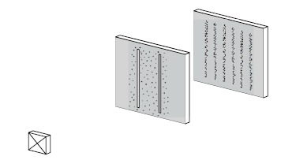
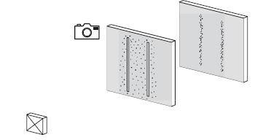
Wave-particle duality and probabilistic nature – double slit experiment
Repeat with two slits
Instead of two vertical lines on the surface behind the two slits, an interference pattern is seen.
If a bleeping electron measurement device was placed on one of the slits, in 50% of the cases the device would bleep indicating the passing of an electron, and resulting in two vertical lines on the surface behind the two slits

Slide 19
Wave-particle duality and probabilistic nature – double slit experiment
The electron after leaving the electron gun lose their connection with our reality and becomes a wave.
The wave function describes the probabilities of the electron’s whereabouts the moment it comes into contact with our reality.
Therefore, putting measurement device or detection mechanism in one of the slits, the wave function collapses into a particle passing through the slit or not passing through the slit.
The electron continues to be a single electron and can’t interfere with itself, and not creating the interference pattern
If there are no measuring devices on either slits, the wave continues to exist and will pass through the two slits at the same time, interfering with itself.

Slide 20
Wave-particle duality and probabilistic nature – double slit experiment
The moment the electron hit the surface behind the slits, the wave function collapses and decides:
with a probability based on its wave amplitudes, where the electron should actually hit, creating the famous interference pattern if performed many times
The interference pattern is based on the probability of the particle hitting the exact spot and not by the particle interfering with itself.
At the center of the surface, in between the two slits, the probability is highest since the distance the wave has to travel is smallest and the amplitude is highest.

Slide 21
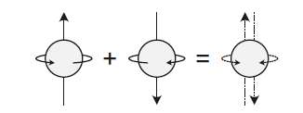
superposition
Some objects like electrons have properties that can be in a state of superposition where the state can be multiple values at the same time
One of the properties of electrons used for superposition is spin.
An electron has two kinds of spin namely spin-up and spin-down or it can be in the superposition of spin-up and spin-down
Spin-up
Spin-down
Superposition of Spin-up & Spin-down

Slide 22

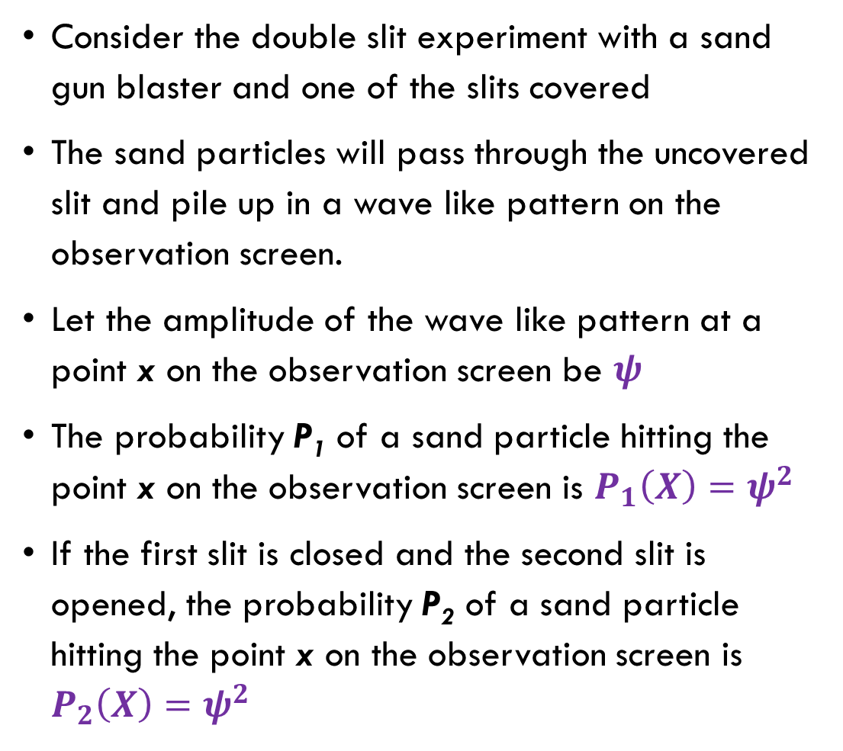
Wave function amplitude probability
Consider the double slit experiment with a sand gun blaster and one of the slits covered
The sand particles will pass through the uncovered slit and pile up in a wave like pattern on the observation screen.
Let the amplitude of the wave like pattern at a point x on the observation screen be $ψ$
The probability P₁ of a sand particle hitting the point x on the observation screen is $P_{1}\left(X\right)=ψ^{2}$
If the first slit is closed and the second slit is opened, the probability P₂ of a sand particle hitting the point x on the observation screen is $P_{2}\left(X\right)=ψ^{2}$
Observation Screen
Sand Pile
Slit -1
X
Slit -2

Slide 23
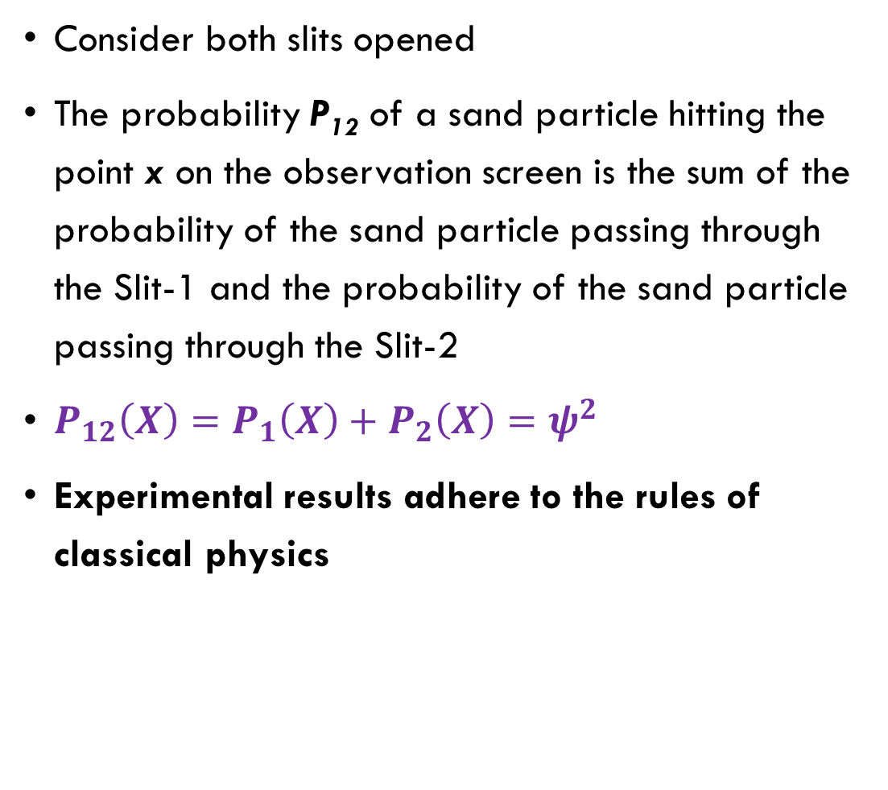
Wave function amplitude probability
Consider both slits opened
The probability P₁₂ of a sand particle hitting the point x on the observation screen is the sum of the probability of the sand particle passing through the Slit-1 and the probability of the sand particle passing through the Slit-2
$P_{12}\left(X\right)=P_{1}\left(X\right)+P_{2}\left(X\right)=ψ^{2}$
Experimental results adhere to the rules of classical physics
Observation Screen
Sand Pile
Slit -1
X
Slit -2

Slide 24

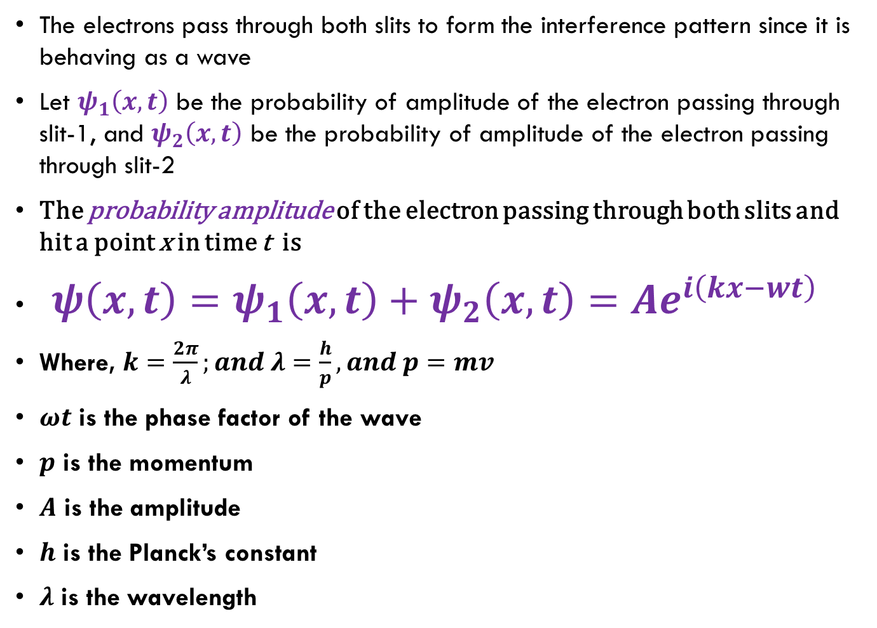
Wave function amplitude probability – using an electron gun
The electrons pass through both slits to form the interference pattern since it is behaving as a wave
Let $ψ_{1}\left(x,t\right)$ be the probability of amplitude of the electron passing through slit-1, and $ψ_{2}\left(x,t\right)$ be the probability of amplitude of the electron passing through slit-2
The probability amplitude of the electron passing through both slits and hit a point x in time t is
${ψ\left(x,t\right)=ψ}_{1}\left(x,t\right)+ψ_{2}\left(x,t\right)=Ae^{i\left(kx−wt\right)}$
Where, $k=\frac{2π}{λ};and λ=\frac{h}{p}, and p=mv$
$ωt$ is the phase factor of the wave
$p$ is the momentum
$A$ is the amplitude
$h$ is the Planck’s constant
$λ$ is the wavelength

Slide 25
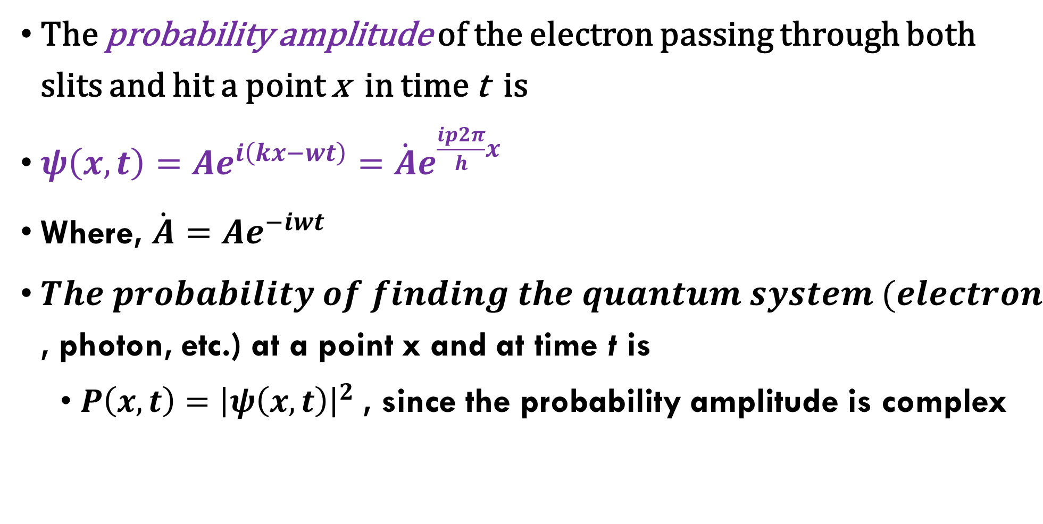
Wave function amplitude probability – using an electron gun
The probability amplitude of the electron passing through both slits and hit a point x in time t is
$ψ\left(x,t\right)=Ae^{i\left(kx−wt\right)}=\dot{A}e^{\frac{ip2π}{h}x}$
Where, $\dot{A}=Ae^{−iwt}$
$The probability of finding the quantum system (electron$, photon, etc.) at a point x and at time t is
$P\left(x,t\right)={\left|ψ\left(x,t\right)\right|}^{2}$, since the probability amplitude is complex

